Slide 1
RPA
Use Cases
MAMATA SHEE

Slide 2




Agenda
What is Automation
What is RPA
Use cases of RPA
Conclusion

Slide 3

What is Automation?
Automation
Automatic
Operation

Slide 4
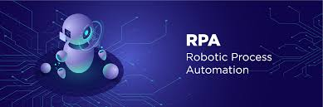

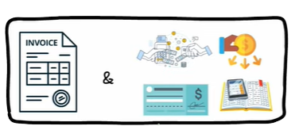

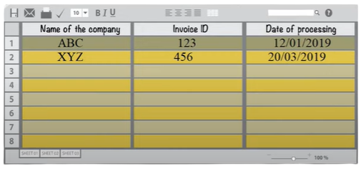
What is RPA?

Slide 5






Slide 6
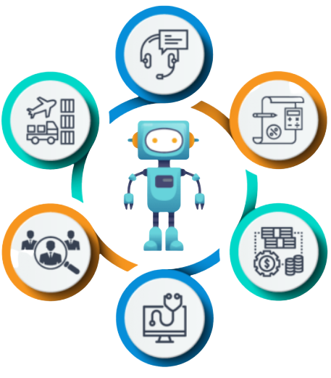


RPA Use Cases
Telecommunications
Information
Technology
Banking &
Accounting
Human Resource
Insurance
Healthcare

Slide 7
Track medical records
Automatically OTP generation
Price analysis
Document digitization process
Single-click complex system install
Guidance on customer's first call
Schedule patient appointment
Automatically reboots, restarts
RPA on
Telecommunications
RPA on Healthcare
RPA on
Information Technology

Slide 8
Manage employee data
Track account
Fetch data from registration form
Company reviews track
Easily handle KYC
Data extraction from different data formats
Resume shortlist
Open an account
Information collection
RPA on
Human Resource
RPA on Banking
RPA on Insurance

Slide 9
Conclusion
RPA has the ability to both minimize manual errors and improve efficiency.
Repetitive work will be accomplished more quickly and efficiently, so humans can be free to focus on more human-centric strengths such as reasoning, judgment, and emotional intelligence.
Robotic Process Automation can be easily introduced, and initial processes can be automated quickly in any of the industries. Hence, makes it a good way to approach the topic of digitization in a company or to expand it further.

Slide 10
Thank
You

